Slide 1
Operating Systems
Practical Session 7,
Memory

Slide 2
Virtual Memory
Virtual memory is a memory management technique that maps memory addresses used by a program, called virtual addresses, into physical addresses in computer memory.
Main storage as seen by a process or task appears as a contiguous address space.
The operating system manages virtual address spaces and the assignment of real memory to virtual memory.

Slide 3
Virtual Memory Advantages
The primary benefits of virtual memory include
freeing applications from having to manage a shared memory space
increased security due to memory isolation
being able to conceptually use more memory than might be physically available

Slide 4
Swapping
Swapping basically means we bring the entire process to memory, use it, and possibly put it back to our store (e.g. large enough disk).
Swap time proportional to the amount of swapped memory – a heavy operation.
Creates holes in memory.
Hardly used anymore…

Slide 5
Paging
What happens when the process’s memory requirements are too large to fit into the physical memory?
Only part of the program reside in memory while the rest stays in the backing store.
That is, an address space which is independent of physical memory is assigned to each process.
On a 32 bit machine, there are 2³² addresses in virtual memory.

Slide 6
Paging
The virtual address space is divided into pages.
The corresponding units on physical memory are called page frames or frames.
The mapping of pages to page frames can be too large to effectively answer our demands.
Solution: use a two level page system.

Slide 7
XV6 memory management
// Return the address of the PTE in page table pgdir
// that corresponds to virtual address va. If alloc!=0,
// create any required page table pages.
static pte_t * walkpgdir(pde_t *pgdir, const void *va, int alloc) {
pde_t *pde;
pte_t *pgtab;
pde = &pgdir[PDX(va)];
if(*pde & PTE_P){
pgtab = (pte_t*)p2v(PTE_ADDR(*pde));
} else {
if(!alloc || (pgtab = (pte_t*)kalloc()) == 0) return 0; // Make sure all those PTE_P bits are zero. memset(pgtab, 0, PGSIZE); // The permissions here are overly generous, but they can
// be further restricted by the permissions in the page table
// entries, if necessary.
*pde = v2p(pgtab) | PTE_P | PTE_W | PTE_U;
}
return &pgtab[PTX(va)];
}
#define PDXSHIFT 22 // offset of PDX in a linear address
#define PDX(va) (((uint)(va) >> PDXSHIFT) & 0x3FF)
#define PTE_ADDR(pte) ((uint)(pte) & ~0xFFF)
#define PTXSHIFT 12 // offset of PTX in a linear address
#define PTX(va) (((uint)(va) >> PTXSHIFT) & 0x3FF)

Slide 8
Disccusion
Page size calculation
Discussion about size of PT (flags)
Hardware translation from Virtual address to Physical address
Malloc

Slide 9
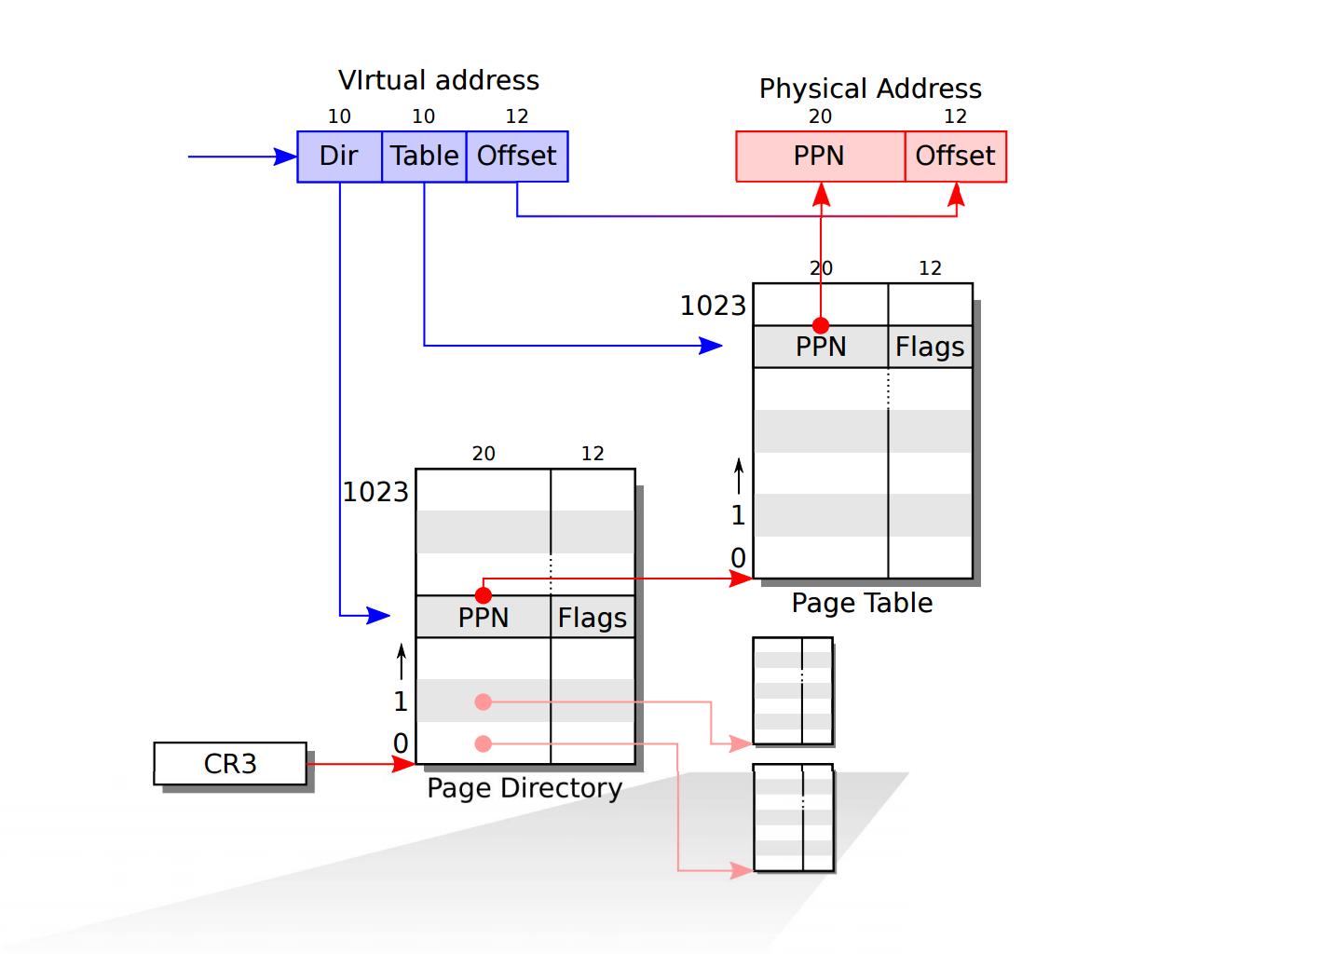

Slide 10
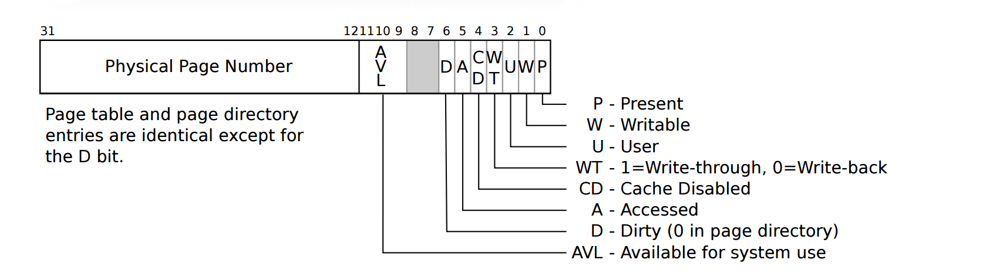
Page table entry

Slide 11
XV6 memory management
// Create PTEs for virtual addresses starting at va that refer to
// physical addresses starting at pa. va and size might not
// be page-aligned.
static int mappages(pde_t *pgdir, void *va, uint size, uint pa, int perm) {
char *a, *last;
pte_t *pte;
a = (char*)PGROUNDDOWN((uint)va);
last = (char*)PGROUNDDOWN(((uint)va) + size - 1);
for(;;){
if((pte = walkpgdir(pgdir, a, 1)) == 0) return -1;
if(*pte & PTE_P) panic("remap");
*pte = pa | perm | PTE_P;
if(a == last) break;
a += PGSIZE;
pa += PGSIZE;
}
return 0;
}
#define PGROUNDDOWN(a) (((a)) & ~(PGSIZE-1))

Slide 12
XV6 memory management
// Free the page of physical memory pointed at by v, // which normally should have been returned by a
// call to kalloc(). (The exception is when
// initializing the allocator; see kinit above.)
void kfree(char *v) {
struct run *r;
if((uint)v % PGSIZE || v < end || v2p(v) >= PHYSTOP) panic("kfree");
// Fill with junk to catch dangling refs.
memset(v, 1, PGSIZE);
if(kmem.use_lock) acquire(&kmem.lock);
r = (struct run*)v;
r->next = kmem.freelist;
kmem.freelist = r;
if(kmem.use_lock) release(&kmem.lock);
}
// Allocate one 4096-byte page of physical memory.
// Returns a pointer that the kernel can use.
// Returns 0 if the memory cannot be allocated.
char* kalloc(void) {
struct run *r;
if(kmem.use_lock)
acquire(&kmem.lock);
r = kmem.freelist;
if(r) kmem.freelist = r->next;
if(kmem.use_lock) release(&kmem.lock);
return (char*)r;
}
struct run { struct run *next; };

Slide 13
Quick recap – TLB
Translation Look aside Buffer (associative memory) is a small table residing in the MMU.
Each entry contains information about one page.
The TLB maps virtual pages to a physical address without going through the page table.
Traditionally implemented in hardware (lookup of entries is done in a single step).
When a miss occurs, an ordinary page table lookup is made (and the TLB is updated).

Slide 14
Homework

Slide 15
Question 1
Assume a 32 bit system, with 2-level page table (page size is 4KB, |p₁|=|p₂|=10bits, |offset|=12bits). Program “A” on this system requires 12 MB of memory. The bottom 4MB of memory are used by the program text segment, followed by 4MB for data and lastly, the top 4MB for stack.
How many page table pages are actually required for this process.
Describe the lookup within the page tables of address 0x00403004.
Notes:
The 12 least significant digits in this address, allow access for 2¹² bytes – 4 KB.
These are pointed to by any of the 2¹⁰ entries of p₂. In total, a second level page table can point to 2²² bytes – 4 MB.
0x00403004
0000000001 = 1_{(dec)}
0000000011 = 3_{(dec)}
000000000100 = 4_{(dec)}

Slide 16
Question 1
We use the following scheme:
The 12 least significant digits in this address, allow access for 2¹² bytes – 4 KB.
These are pointed to by any of the 2¹⁰ entries of p₂. In total, a second level page table can point to 2²² bytes – 4 MB.
Each such page table is pointed to by a first level table entry.
In our case – we require 4 page table pages: a single first level page table (also known as the “directory”), which points to 3 second level page tables.
page offset
p₁
p₂
d
10
10
12

Slide 17
Question 1
Top-level page table
1023
1023
4095
page number
page offset
4
p₁
p₂
d
3
4
2
10
10
12
1
4
3
0
3
2
2
1
1023
1
0
0
32 bit virtual address, 4K pages, lookup of 0x00403004 (4,206,596_{(dec)})
4
3
Binary:
0000000001 = 1_{(dec)}
0000000011 = 3_{(dec)}
000000000100 = 4_{(dec)}
2
1
4 – 8 MB
0
12288 – 16383 Byte

Slide 18
Question 2
Consider a paged memory system with a two-level page table. If the reference time to access the physical memory takes 20 nanoseconds (ns), how long does a paged memory reference take? Assume that the second-level page table is always in memory, and:
There is no TLB, and the needed page is in main memory.
There is a TLB, with access speed of 0.05 ns, the needed page is in main memory and
The TLB does not contain information on this page.
The TLB contains information on this page.

Slide 19
Question 2
We will need to access the memory three times: in the first and second accesses we will get the first and second level page table entry. This will point us to the physical address we will access next. Total time: 3x20 = 60ns.
Remember we first access the TLB:
Since this entry is not located in the TLB, after examining it, we will revert to the regular lookup scheme (as before). Total time: 0.05+3x20 = 60.05ns.
If the entry is in the TLB, after examining it we will know the location of the exact page frame and access it directly. Total time: 0.05+20 = 20.05ns.
Note that the use of virtual memory may significantly reduce memory performance. The TLB provides a mechanism to overcome this problem.

Slide 20
Question 3
Consider a computer with an address space of 32 bits, and a 2KB page size.
What is the size of the page table (single level)? What is the maximal size of a program’s memory? Does it depends on the size of the pages?
Assume a two level page table, in which 8 bits are dedicated for the first level table. What is the size of the 2nd table (per first level entry)? Can we run larger programs now?
Assume that the first level table is always in memory and a page fault occurs with a 4% chance when attempting to access the pages it points to. When retrieving pages pointed to by the second level table a PF occurs in 1% of the attempts. Calculate the average access time to a page, if disk access time is 30x10⁻⁶sec, and memory access time is 100x10⁻⁹sec.
Notes:
The virtual memory size is 2³² bytes, size of each page is 2KB (2¹¹ bytes).
Total number of pages is therefore 2³²/2¹¹=2²¹ pages. Since each address is 4 bytes long (32 bit machine), we require 4x2²¹ = 2²³ bytes = 8 MB to hold this table.

Slide 21
Question 3
The virtual memory size is 2³² bytes, and the size of each page is 2KB (2¹¹ bytes). Total number of pages is therefore 2³²/2¹¹=2²¹ pages. Since each address is 4 bytes long (32 bit machine), we require 4x2²¹ = 2²³ bytes = 8 MB to hold this table. Maximal program size is 4 GB (size of virtual memory), regardless of the page size.

Slide 22
Question 3
Using 8 bits for the first level page table, leaves us with 13 bits for the second level page table. The size of the second table is 4x2¹³ = 32KB. The size of the virtual memory stays the same, and we can’t run bigger programs.

Slide 23
Question 4
What is the size of a single level page table on a 32 bit machine, with 4KB pages?
What is the size of a 64 bit machine’s page table with 4KB pages? How many layers will we need if we want to ensure that each page table entry will require only a single page?
What is the size of the inverted page table, for a computer with 2GB RAM, in which each page is 16KB long and each address is 8 bytes long?

Slide 24
Question 4
If the address space consists of 2³² bytes, with 4KB pages, we have 2³²/2¹²=2²⁰ entries (over 1 million). Using 4 bytes per entry, we get a 4MB page table.
With a 64 bit machine, we need 2⁵² entries. Each entry being 8 bytes long results in a 32 PetaBytes (Peta > Tera > Giga) page table. Limiting page table parts to fit the size of a page means that we can only use 2¹²/2³=2⁹ addresses in each table segment. This corresponds to 52/9≈6 levels in this page table. That is, the memory is accessed 6 times to retrieve each virtual address.

Slide 25
Inverted Page Table
Applied to machines with large address space which require significantly more entries in the page table
The IPT uses one entry per frame (physical memory), instead of per page (virtual memory).
Virtual to physical translation may become significantly harder: when process n references virtual page p we now have to go over the entire IPT for an entry (n,p) – this must be done on every memory reference!
Tradeoff: amount of memory required for the page table vs. time required to search for a page.
Solution: use a hash function to speed up search.

Slide 26
Question 5.1, Moed Beit 2010
A given operating system manages memory with the aid of page tables. It is currently executing two programs, A and B (assume that these do not call exec()). Answer the following questions:
If B was created as a result of the fork() system call made by A, can the system use the same page table for both programs?
Assume that both A and B were created from process C (assume that this was done with a single special command – fork2() which is identical to fork in all aspects but the number of processes it creates). can the system use the same page table for both programs in this case?
Now assume that the system is using segmentation with paging and that B was created as a result of the fork() system call made by A. Can the system use the same page table for both programs in at least one segment?

Slide 27
Question 5.1
No. Despite sharing much in common the two programs may execute different code (e.g. allocate memory differently) after the call to fork() is made.
No. Although both execute the same code, progress (in terms of code line executed) may be different. As a result a race over the value of the pages will occur.
Yes. Since the code segment is the same for both (no exec calls are allowed), this segment can be maintained in the same page table.

Slide 28
Question 5.2
The time required to read an entry from the TLB in a given system is 10 nsec. Access time to a single level page table entry is 10 times slower, and requires 100 nsec.
What should be the TLB hit rate so that the average time to find a virtual address will be 30 nsec? Explain your calculation

Slide 29
Question 5.2
The TLB hit rate provides a measure of successful TLB hits when seeking a virtual address. When a successful TLB hit occurs the virtual address is translated directly from the TLB. In contrast, when the page is not in the TLB one has to access the page table.
Let p denote the TLB hit rate. We know that:
p∙10 + (1-p) ∙(10+100) = 30
Thus, the TLB hit rate should be: p=0.8
Notes:
Note: with a high TLB hit rate memory access time is 70% faster!

Slide 30
Question 5.3
Assume that the TLB includes the following entries: valid bit, modified bit, protection code, virtual address and frame number.
Can a single CPU machine which supports multiple processes use a single such TLB without changing it? If it can, explain how this is done otherwise explain why it can’t be done.
Is the same also true for a multi CPU machine? Explain.

Slide 31
Question 5.3
A single CPU machine can use a single TLB (in fact this was the common setup in the days preceding the multi core CPUs). The important thing to remember is that whenever a new process is running the valid bits of all entries should be marked with a 0 (no frames in cache).
This is not true when there are multiple CPUs (or cores). When multiple processes are running both may require the same virtual address which should be translated to two distinct addresses. One means to overcome this problem is by introducing the PID of processes as another field in the TLB.

Slide 32
Shared memory
Linux permits processes to share memory
This allows more complicated inter-process communication
Shared memory is first allocated using the command shmget
Following the allocation, processes request access to the shared memory using the command shmat

Slide 33
Shared memory - Allocation
#include <sys/types.h>
#include <sys/ipc.h>
#include <sys/shm.h>
...
key_t key; /* */
int shmflg; /* flags passed to shmget() */
int shmid; /* id of allocated memory */
int size; /* number of bytes to to assign */
...
key = ...
size = ...
shmflg = ...
if ((shmid = shmget (key, size, shmflg)) == -1) {
perror("shmget: shmget failed");
exit(1);
}
...
Code taken from: http://www.cs.cf.ac.uk/Dave/C/node27.html
Notes:
Different processes refer to the same shared memory using the same key

Slide 34
Shared memory example: Server
key = 5678; // We'll name our shared memory segment "5678".
// Create the segment.
if ((shmid = shmget(key, SHMSZ, IPC_CREAT | 0666)) < 0) {
perror("shmget"); }
// Now we attach the segment to our data space.
if ((shm = shmat(shmid, NULL, 0)) == (char *) -1) {
perror("shmat");
}
// Put some things into the memory for the other process to read.
s = shm;
for (c = 'a'; c <= 'z'; c++)
*s++ = c;
*s = NULL;
// wait for the other process to change the first char
while (*shm != '*')
sleep(1);
Code taken from: http://www.cs.cf.ac.uk/Dave/C/node27.html
Notes:
Different processes refer to the same shared memory using the same key.
In this example the server allocated shared memory and writes a string in it, the waits for the first character to be changed to an asterix. The client reads the string and changes the first character into an asterix

Slide 35
Shared memory example: Client
key = 5678; // We named the shared memory segment "5678“
// Locate the segment
if ((shmid = shmget(key, 27, 0666)) < 0) {
perror("shmget");
}
// Attach the segment to out data space
if ((shm = shmat(shmid, NULL, 0)) == (char *) -1) {
perror("shmat");
}
// Read the string written by the server
for (s = shm; *s != NULL; s++)
putchar(*s);
putchar('\n');
// Change the first character
*shm = '*';
Code taken from: http://www.cs.cf.ac.uk/Dave/C/node27.html

